Slide 1


Slide 2


GOVERNMENT OF INDIA • FLAGSHIP PROGRAMME
DIGITAL
INDIA
TEAM = DIGIRISE
______________________________________________
ANKIT KUMAR
RISHI KUMAR
B-Tech{CSE}
Notes:
1

Slide 3




What is Digital India?
Digital India is a flagship programme of the Government of India, launched to transform the nation into a digitally empowered society and knowledge economy. It brings more than 30 ministries and departments together under one shared digital roadmap — making technology the backbone of governance, the economy and everyday life.
A Unified National Vision
Brings together more than 30 ministries and departments under one shared digital roadmap.
Citizen-Centric by Design
Services are designed around people’s needs, not administrative boundaries.
Technology as a Bridge, Not a Barrier
Making digital tools a means of inclusion for every Indian, urban or rural.
02 / 15
Notes:
2

Slide 4




Launch & Key Facts
1 July 2015
MeitY
Launched in New Delhi during Digital India Week, by Prime Minister Narendra Modi.
Ministry of Electronics &Information Technology — the nodal ministry steering the mission.
₹1,13,000 Cr
₹14,903 Cr
Original outlay approved for the
Digital India programme at launch
Additional outlay approved by the cabinet
in August 2023 to expand the mission
04 / 15
Notes:
4

Slide 5









Nine Pillars of Digital India
1. Broadband Highways
2. Universal Mobile Connectivity
3. Public Internet Access
Optical-fibre network for rural & urban India.
Closing network gaps in remote villages.
Common Service Centres & post offices as hubs.
4. e-Governance
5. e-Kranti
6. Information for All
Reforming government through technology.
Electronic delivery of services nationwide.
Open data & proactive public disclosure.
8. IT for Jobs
9. Early Harvest Programmes
7. Electronics Manufacturing
Quick-win projects like MyGov, e-Greetings.
Toward net-zero electronics imports.
Training youth for IT & BPO careers.
06 / 15
Notes:
6

Slide 6




Decade of Digital Transformation
2015 – 2025: the scale of change, at a glance
97 Cr+
144 Cr+
72 Cr+
Internet Users
Aadhaar IDs Issued
DigiLocker Users
5 Lakh+
116 Cr
99.6%
Common Service Centres
Mobile Subscribers
Districts with 5G Coverage
12 / 15
Notes:
12

Slide 7





DIGITAL INFRASTRUCTURE
5G rolled out nationwide since October 2022
4.74 lakh 5G towers installed within just 22 months
99.6% of India’s districts now covered by 5G
116 crore mobile subscribers across the country (2025)
BharatNet is connecting Gram Panchayats via optical fibre
07 / 15
Notes:
7

Slide 8
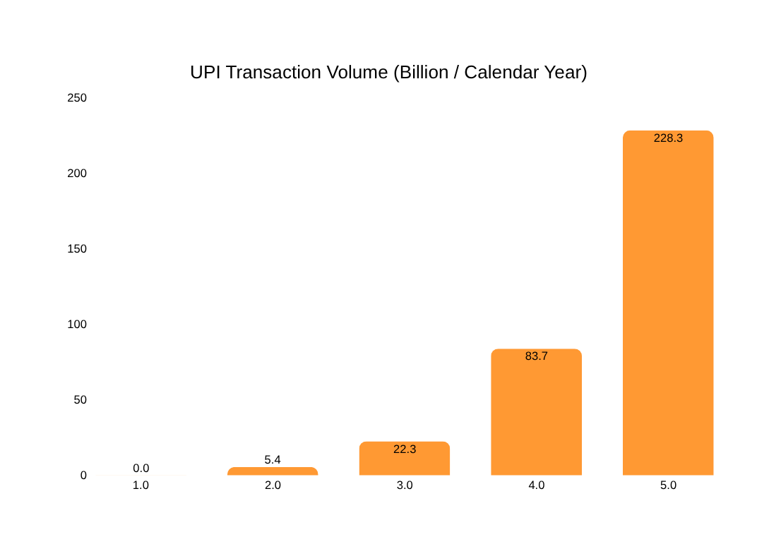
UPI — Powering a Cashless Economy
24,162 Cr
UPI transactions processed in FY 2025-26, up 30% year-on-year
₹314 Lakh Cr
Total value of UPI transactions in FY 2025-26
~85%
Share of all digital payments in India carried over UPI
8+ Countries
Now accept UPI, including the UAE, France, Singapore & Nepal
09 / 15
Notes:
9

Slide 9

Towards a Digitally
Empowered Bharat
Digital India has taken the country from a billion-plus population to a billion-plus digital identities — reshaping how citizens, businesses and government meet. The journey ahead continues toward an even more connected, inclusive and self-reliant nation.
$1 Trillion
Viksit Bharat
@ 2047
Digital Economy by 2030
Notes:
15

Slide 10


